Slide 1
Analysis of Wind Turbine Performance
By – SUMEDH Kumar Prasad

Slide 2
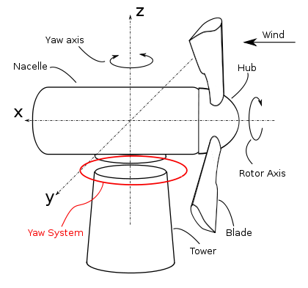
Assignment Study
Two Wind Turbine data is given.
10 min performance data for two turbines from 2013-06-01 to 2014-01-01. Here 10 min refer to signals are compressed into 10 minutes interval and correspondingly data points average over 10 min period.
The important measure of performance for Power Curve is the relationship between wind turbine power and free flow wind at hub height.
We refer hub height because air density will be less from ground level. So, friction in the will also less.
The yaw system of wind turbine is the component responsible for the orientation of the
wind turbine rotor towards the wind.

Slide 3
Data Description
Column Name | Data Type | Short Discription | Unit of Measure
unitlocation | Character | It has two unit location "WTG01" and "WTG02"
ttimestamplocal | Date Time | 01-06-2013 11:50:00 PM " is in format DD-MM-YYYY HH:MM:SS"
power | Numeric | Avg. Power generated | kW
windspeed | Numeric | Avg. Wind Speed | m/s
airdensity | Numeric | Avg. Air Density | kg/m^3
amb_temp | Numeric | Avg. Outside Temperature | deg C
nac_direction | Numeric | Avg. nacelle direction | deg
blds_pitchangle | Numeric | Avg. pitch angle of Blades | deg
rtr_rpm | Numeric | Avg. Rotar Speed | rpm
gen_rpm | Numeric | Avg. Generator Speed (30-60 rotations per minute (rpm), to about 1,000-1,800 rpm ) | rpm
wtg_state | Character | Turbine Status
wtg_state | Short Discription
Ok | The turbine is in normal operation
Curtailed | The turbine is limited in output
gen not conn | The genrator is not connected and turbine is off
wind low | Wind speed is too low to operate
high wind cut-out | Wind speed is too high to operate
service | The turbine is in service
data error | The data reading are not within the Expected limits

Slide 4
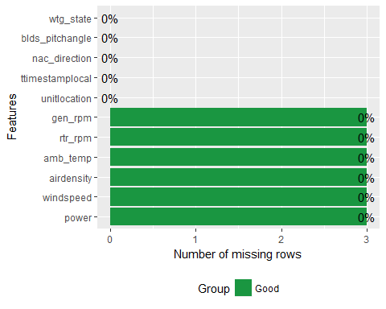
Exploratory Data Analysis (EDA)
introduce(wtdata)
## rows columns discrete_columns continuous_columns all_missing_columns ## 1 61269 11 3 8 0 ## total_missing_values total_observations memory_usage ## 1 18 673959 6625872
The total number of rows is 61269 and columns is 11.
There are 3 discrete columns and 8 continuous columns.
There are 18 missing values which is spread across 3 rows.
Two rows with turbine “service” state and one row with generator not connected.
Top wind turbine state wise category
## wtg_state cnt pct cum_pct ## 1: ok 44020 0.71850619 0.7185062 ## 2: wind low 8658 0.14131819 0.8598244 ## 3: curtailed 4187 0.06834133 0.9281657

Slide 5
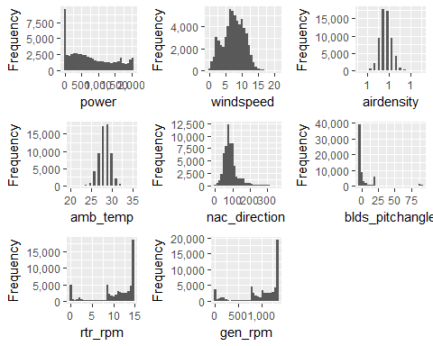
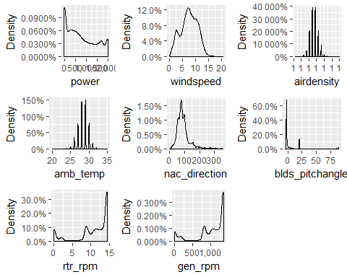
Histogram and Density Plot
# nac_direction is right skewed which means that most of the values is in between 50 to 150. # rotor and generator rpm follow the left skew distribution. # Most of the blade pitch angle between -1 to +25 degree.
# Power is spread is from 0 to 2000. # Wind Speed is distributed like weibull Distribution curve. # Air Density also distributed like Normal Distribution curve. # amb_temp is distributed like Normal Distribution.
# blade pitch angle is left skewed.

Slide 6
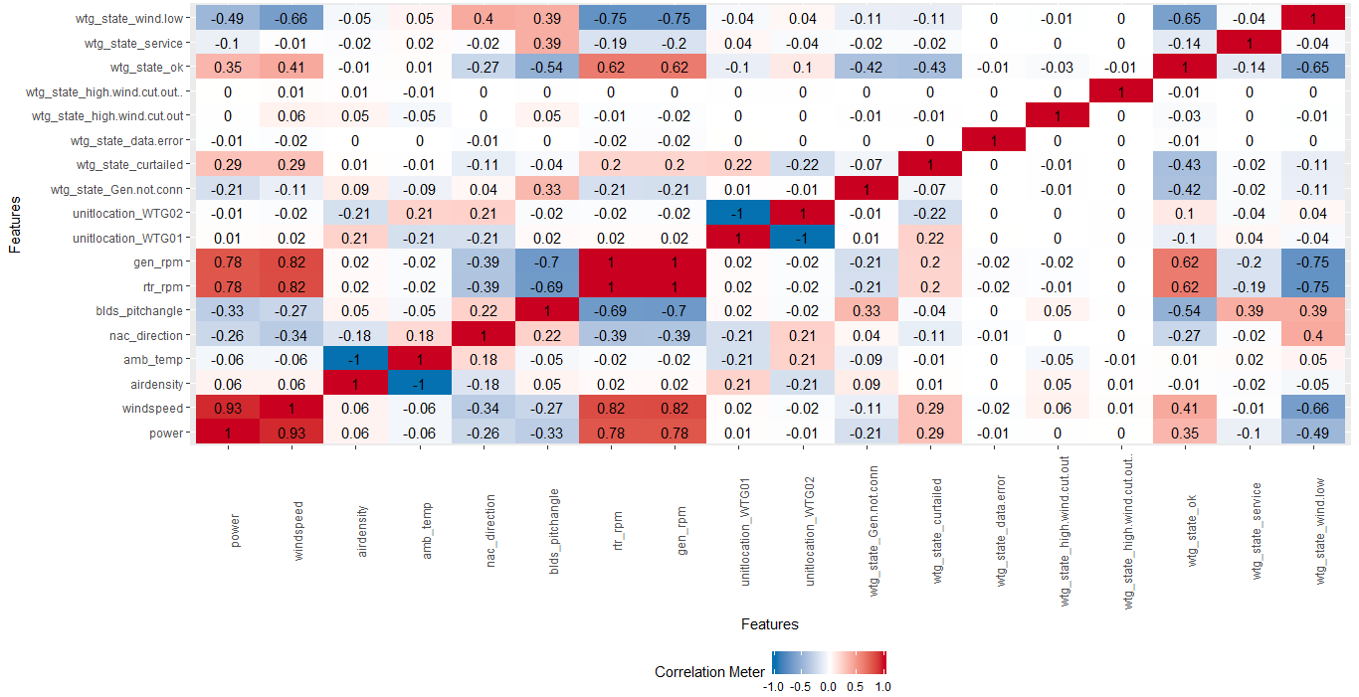
Correlation Plot
Inference from Correlation Plot
# power with wind speed is highly correlated after that generator and rotor speed. # With Winds peed also rotor and generator rpm is correlated # Wtg_state_ok is correlated with the rotor and generator rpm.

Slide 7
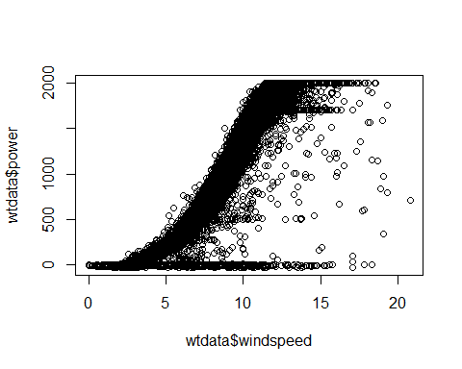
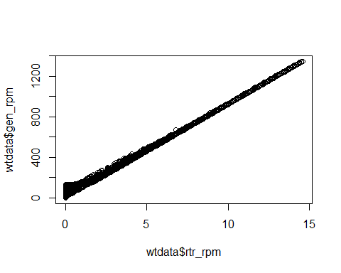
Scatter plot between Wind Speed Vs Power
Scatter plot between Rotor Speed Vs Generator Speed
The Scatter plot between wind speed vs power is a sigmoid graph but There is also some data which is scatter form. But Ideally graph should be in “S” shape.
The Scatter plot between rotor speed vs generator speed is highly correlated. As rotor speed increase then generator speed also increases.

Slide 8
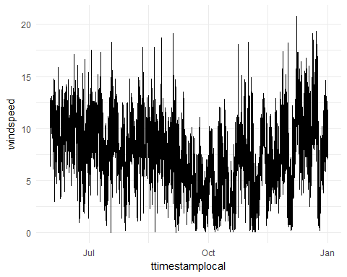
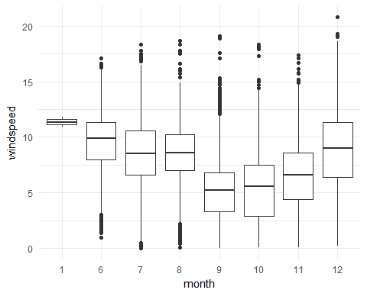
Wind Speed plot w.r.t time and Month
# From the graph it is clear that Avg. wind speed is deceasing from June to October and then started increasing from October to January again. Same inference also clear from boxplot with month wise plot.

Slide 9
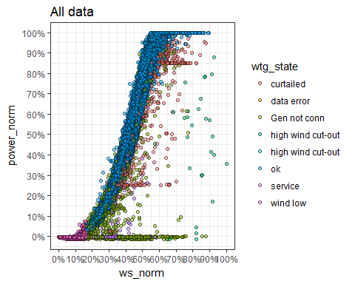
Power Curve for Wind Turbine State
Power curve for all wind turbine is shown.
Power curve is the relation between wind speed (m/s) and power (kW). The ok state of wind turbine percentage is more and follow sigmoid curve and the data is spread out for all other wind turbine state.

Slide 10
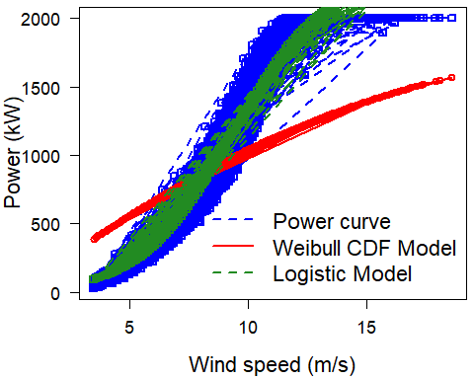
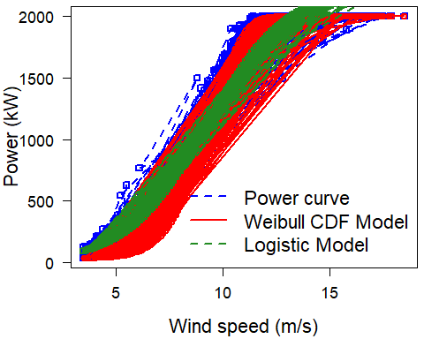
Power curve for Wind Turbine 1 and 2 with ‘ok’ state
Power curve for Wind Turbine 1 with ok state ‘ok’ of wind turbine
Power curve for Wind Turbine 2 with ‘ok’ state of wind turbine
Logistic Function MAPE value is 11.05
Logistic Function MAPE value is 8.90
Hence, by seeing the Turbine1 and Turbine 2 two graph the performance of Wind Turbine 2 is more compare to Wind Turbine 1.It is also evident by seeing the less value of MAPE value 8.90 of Wind Turbine 2.

Slide 11
Comparing MAPE value month wise
for both Turbines
Comparing MAPE value month wise
and Turbine wise also.
In month wise analysis MAPE value is very high in September month with ‘ok’ state of the Turbine.
In month and turbine wise analysis MAPE value is very high in September month with ‘ok’ state of the Turbine.
Overall performance of WT 2 is better than WT 1.
In both graph MAPE value start increasing from June to September then from September to December start decreasing

Slide 12
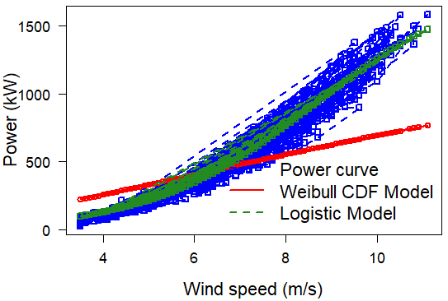
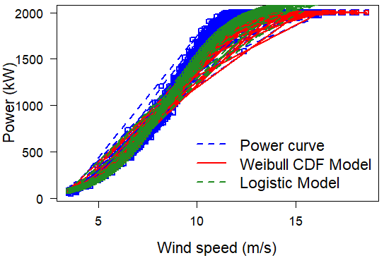
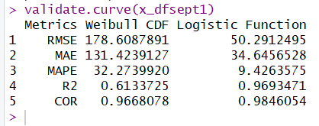
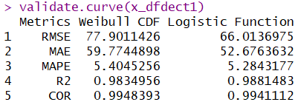
Power Curve Analysis for Wind Turbine 1 with ok State of Wind Turbine
For September Month Analysis poor Power curve
For December Month Analysis Good power curve
In the period between June – December. Power curve is best for December month and poor for September Month.

Slide 13
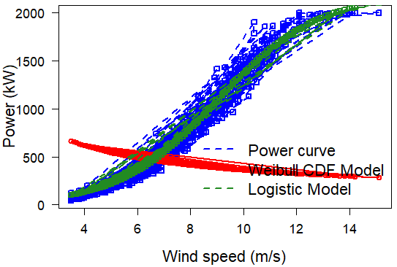
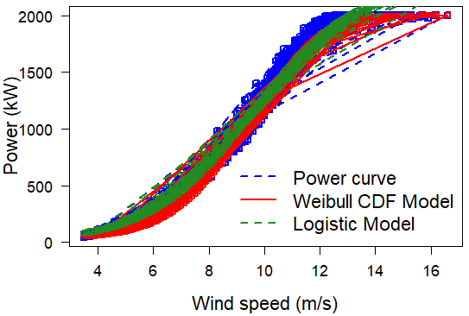
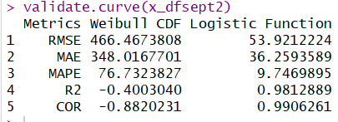
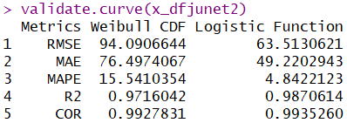
Power Curve Analysis for Wind Turbine 2 with ok State of Wind Turbine
For September Month Analysis poor power curve
For June Month Analysis Good power curve
In the period between June – December. Power curve is best for June month and poor for September Month.

Slide 14
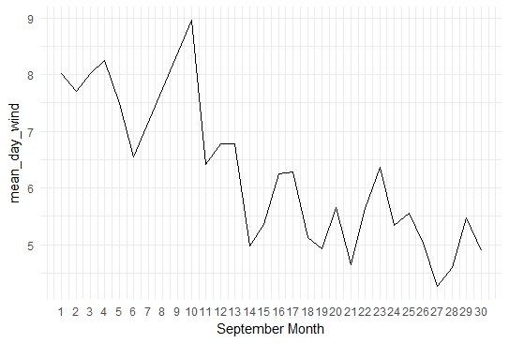
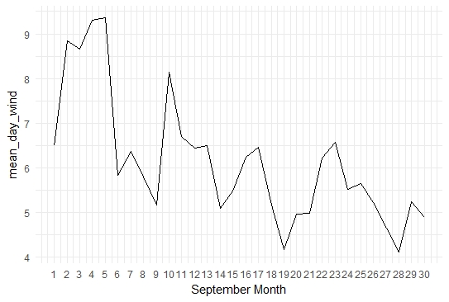
Graph of average day wise wind speed with September month for Turbine 1 and Turbine 2 because of poor performance
Turbine 1 average day wise wind Speed of September Month
Turbine 2 average day wise wind Speed of September Month
September 14th,21st and 27th having the lowest wind speed in Wind Turbine 1 with Sep month and Ok State of Wind Turbine which effect the performance of wind Turbine1.
September month 9th,14th,19th,28th having the lowest value wind speed in Wind Turbine 2 and Ok state of wind turbine which effect the performance of wind Turbine 2.

Slide 15
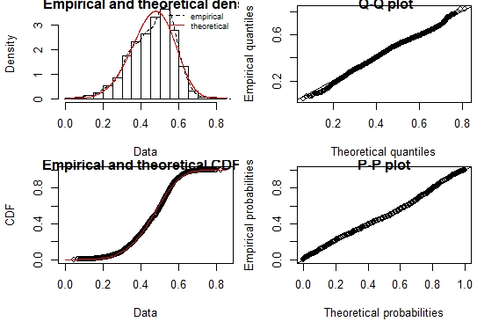
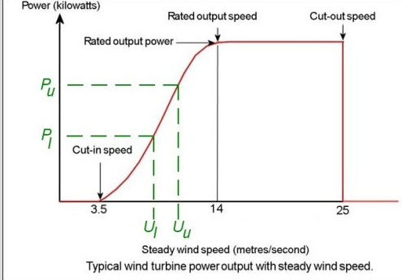

Wind Speed Follow Weibull Distribution
Weibull distribution on Wind Speed.
Wind power output is highly variable and varies with weather a lot . However, whilst the power output from a turbine cannot be predicted for a particular time, it is possible to estimate the proportion of time that the turbine produces different levels of power. For the Weibull distribution, it can be shown that the proportion of time T_{i} that the wind speed lies between two such limits is:
where Um is the mean Wind Speed.

Slide 16
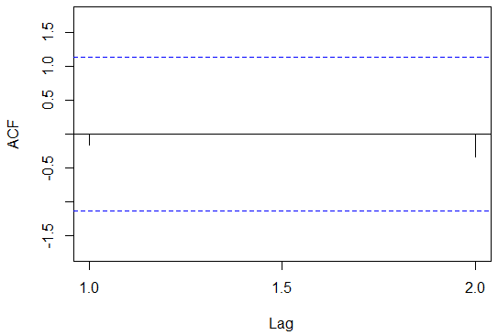
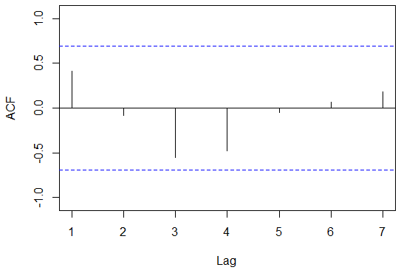
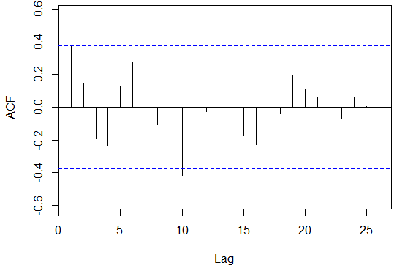
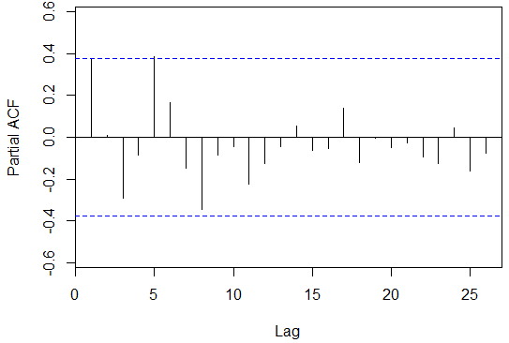
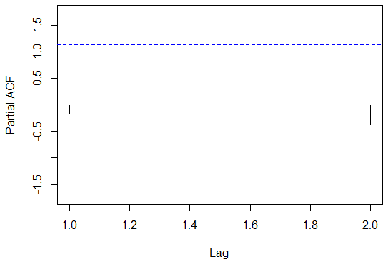
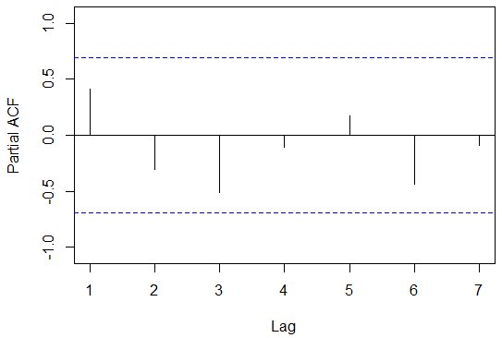
Analysis of ACF and PACF with Wind Speed
With frequency 31
With frequency 7
With frequency 12
ACF
ACF
ACF
PACF
PACF
PACF
Data is correlated in ACF and PACF graph with frequency is 31. ACF peaks at 2,9 ,10 and 11
Data is uncorrelated in ACF and PACF graph with frequency is 7
Data is uncorrelated in ACF and PACF graph with frequency is 12
ACF measured the linear relationship between lagged value of time series y and does not control other lag.
PACF is the Time series with its own lagged value controlling for the values of the time series at all shorter lags.

Slide 17
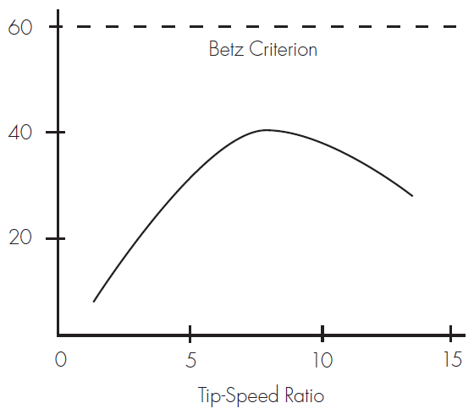
Ques 4 Could this be a Sensor Error or Turbine Performance issue?
Answer 4 After all analysis carried out it refers that Turbine Performance issue because power is depend on the wind speed as the wind speed is low the Turbine performance will also decrease.
Ques 5 Are there other data you would like to have included?
Tip Speed Ratio of a wind turbine is an essential factor to how efficient that turbine will perform .This graph to the right shows the relationship between tip-speed ratio (TSR) and the coefficient of power (Cp).
Height of the wind Tower or Hub height.
Direction of the Wind.
Rotor Swept Area: The rotor swept area, A, is important because the rotor is the part of the turbine that captures the wind energy. So, the larger the rotor, the more energy it can capture.
To calculate the Rotor swept area also required Wind Blade radius.

Slide 18
Conclusion
Ok State of wind turbine perform better compare to all other state of wind turbine for both wind turbine.
Overall performance of Wind turbine 2 is better compare to wind turbine 1.
For both wind turbine September month having the highest MAPE values.
September 14th,21st and 27th having the lowest wind speed in Wind Turbine 1 with Sep month and Ok State of Wind Turbine which effect the performance of wind Turbine1.
September month 9th,14th,19th,28th having the lowest value wind speed in Wind Turbine 2 and Ok state of wind turbine which effect the performance of wind Turbine 2.
There is a turbine performance issue due to varying Wind Speed on different days.
The other data I would I like to add is Tip Speed ratio, Hub height, Direction of the Wind , Rotor Swept Area and Wind Turbine Blade Length.

